Slide 1
ECE 554 FPGA Tutorial Virtex-5 XC5VLX110T FPGA

Slide 2
Introduction
Today’s tutorial focuses on introducing you to Xilinx ISE and Modelsim.
These tools are used for
Verilog Coding
Simulation
Synthesis
Board Programming

Slide 3
Tutorial files
The folder “ece554_v5” contains the following file types:
.pptx – the tutorial slides
.v – verilog module or testbench
.ucf – pin definition file that defines the mapping of verilog wires to pins on the physical fpga
.mem – a simple text file that contains data to be read with the $readmem verilog system task

Slide 4
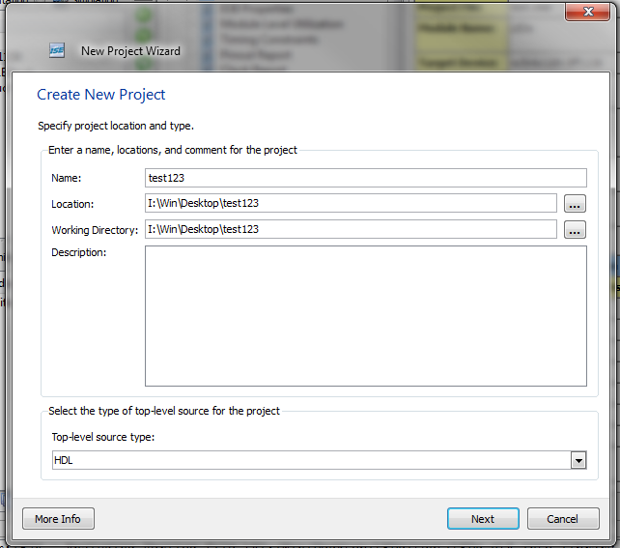
Create a project
Launch the Xilinx ISE 12.1
Create a new project (File->New Project) and save it in your cae account.

Slide 5
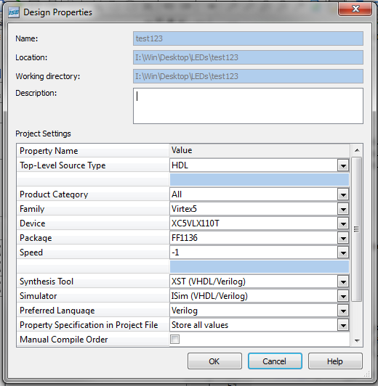
Configure parameters
Configure the parameters for the board configuration and simulation environment (image shows proper values)

Slide 6
Create/Add sources
For now, do not create any new sources and go to the next screen.
For now, do not add any existing sources and go to the next screen.
Click “Finish” to create the new project.

Slide 7
Tutorial Description
The provided project is somewhat simple.
It essentially uses the DVI port for output, the action it performs is multiplying 2 32-bit numbers together and showing their result.
The push buttons (and one dip switch) on the FPGA are used for user input.

Slide 8
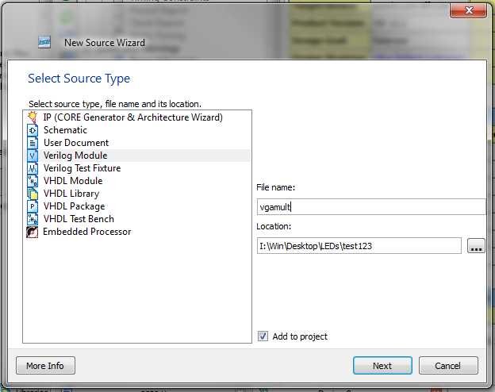
Create new source
In the Sources window, right click and select “New Source”.
Select “Verilog Module” and File name “vgamult” .

Slide 9
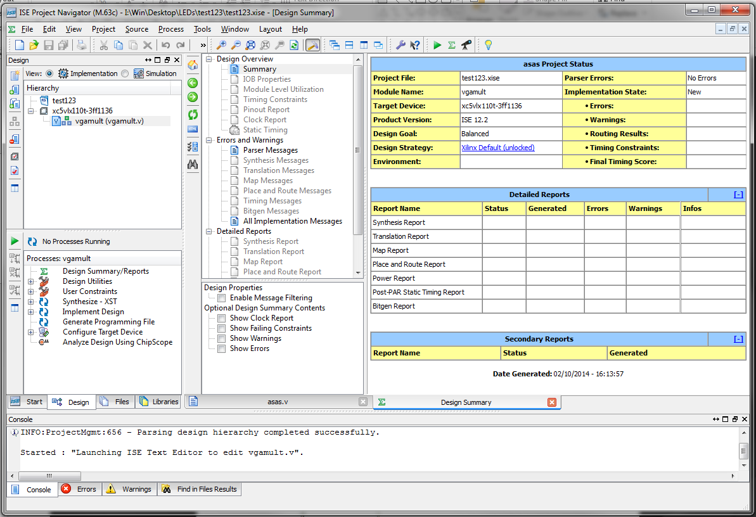
Define module
For now, do not define any port and click “next”.
Click “Finish” to create the new source.

Slide 10
Edit module
In the Source window, double click the created source “vgamult” and the editor view will appear at the main window.
Open the vgamult.v file in the “ece554_v5” folder using any text editor.
Copy all the contents in the vgamult.v to the project source “vgamult”. (Do not forget to save the source file after modifications.)

Slide 11
Create/Edit module
Using the same process (New source and then copy), create the following modules:
vga_logic
main_logic
draw_logic
dvi_ifc
tick_logic
up_counter
simple_rom

Slide 12
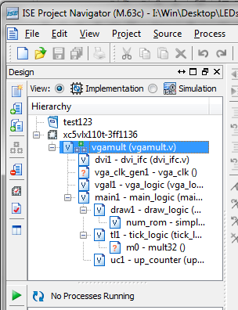
Create Modules
The Source window after creating all the moudles.

Slide 13
Using Coregen
Currently the project is still missing 2 modules (you can see “?”icon before the missing moudle), so it cannot simulate or synthesize at this time. These modules were created with a Xilinx tool called coregen that facilitates the automatic generation of certain modules.
The missing modules are
A clock generator
The board provides a 100MHz clock, but we need to use a clock genrator to perform division in order to create a 25MHz clock for the VGA interface.
A 32x32-bit multiplier
Uses hardware multipliers on the FPGA. To make use of pipelined operation of the multipliers, coregen must be used.

Slide 14
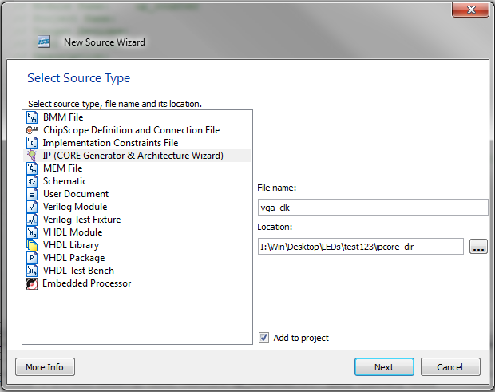
Clock Generator
In the Sources window right click and select “New Source”.
Create an IP(CORE Generator) source called vga_clk

Slide 15
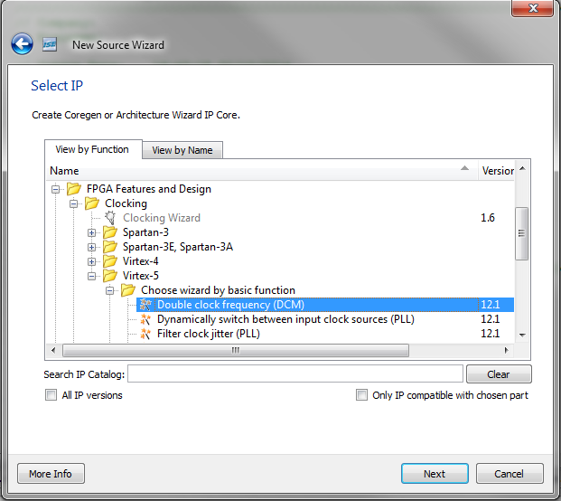
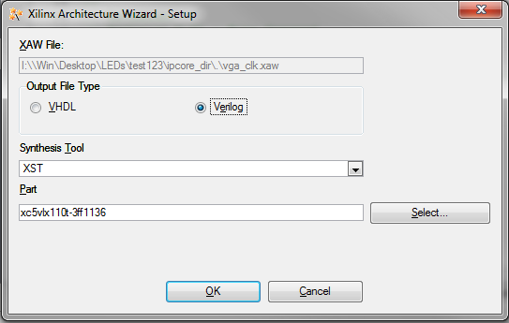
Clock Generator
Create a clock generator. Xilinx refers to them as DCMs. Digital Clock Managers.
Select o/p filetype in next window

Slide 16
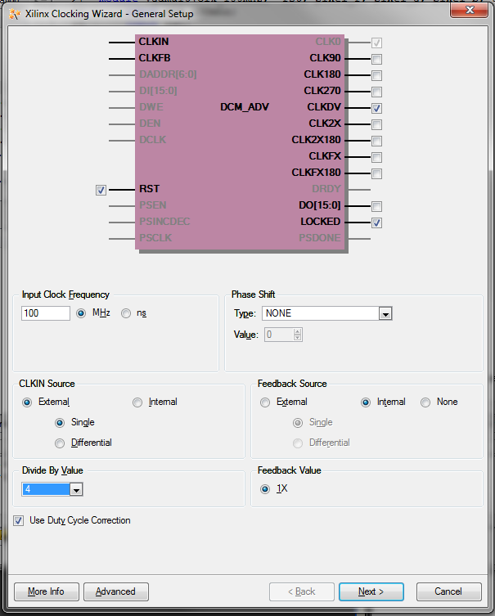
Clock Generator
Configure the clock generator.
Input frequency is 100Mhz
Select CLKDV pin, this will be the output for our synthesized 25MHZ clock.

Slide 17
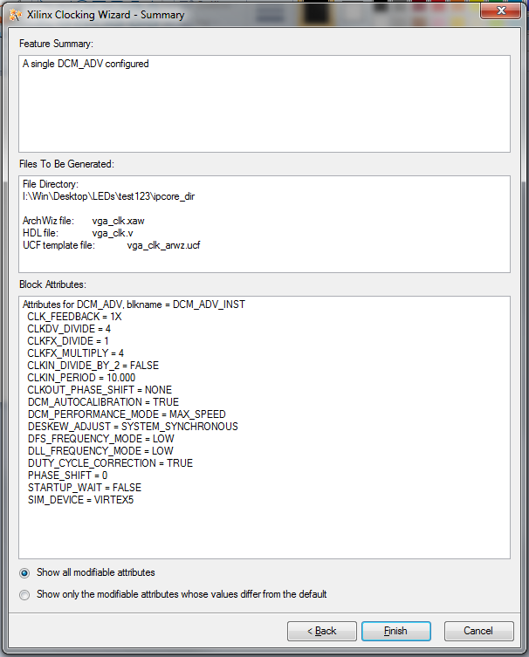
Clock Generator
Configure it for 25Mhz and finish the configuration.
You should notice the vga_clk module now appears within the sources window.

Slide 18
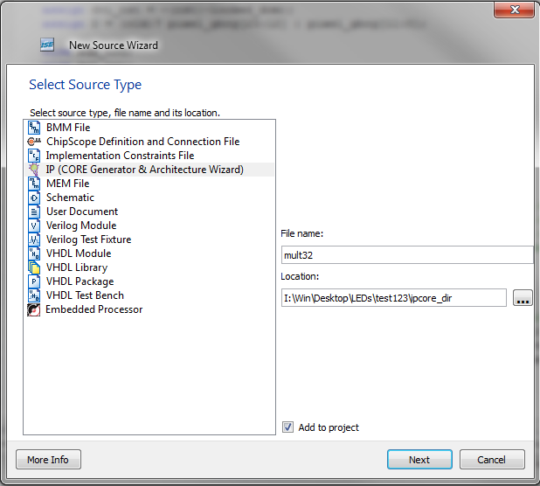
Multiplier
Similarly create a multiplier

Slide 19
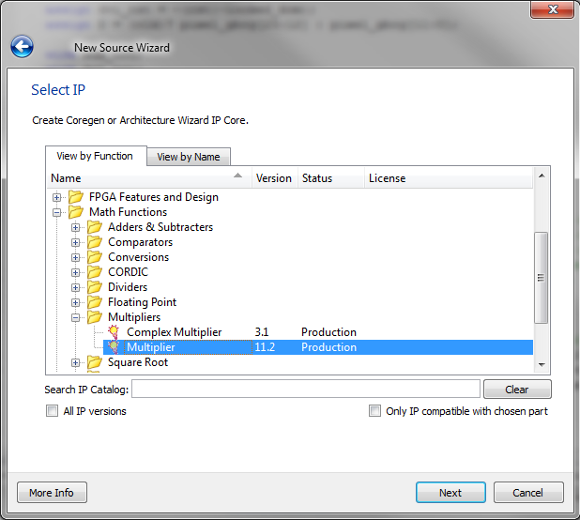
Multiplier

Slide 20
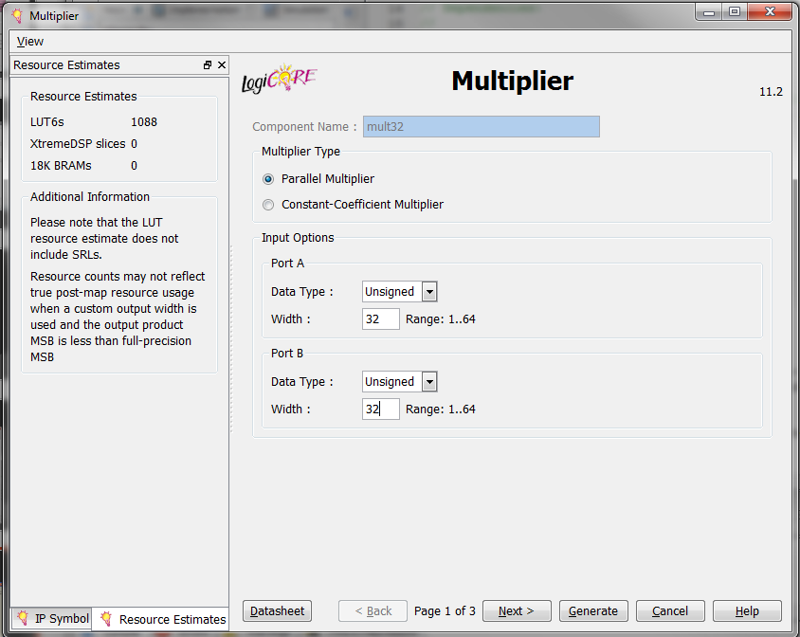
Multiplier

Slide 21
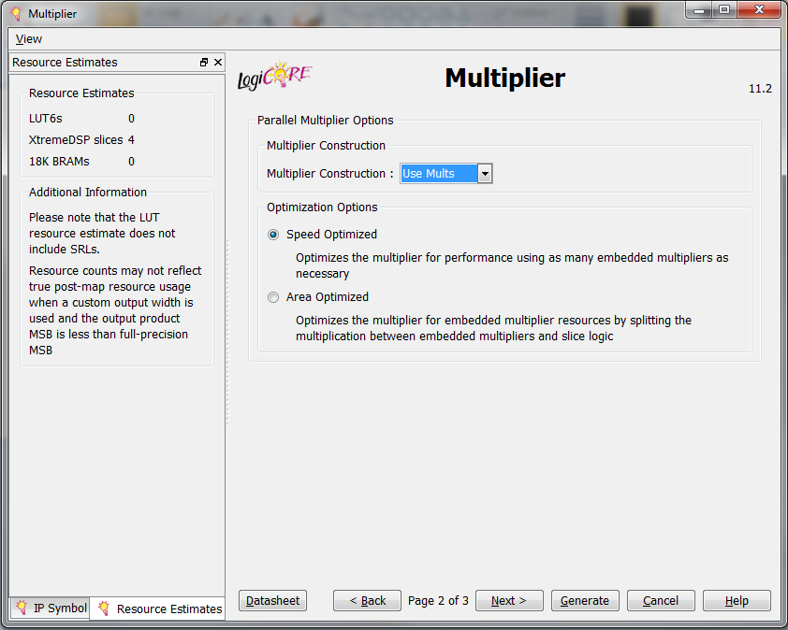
Multiplier

Slide 22
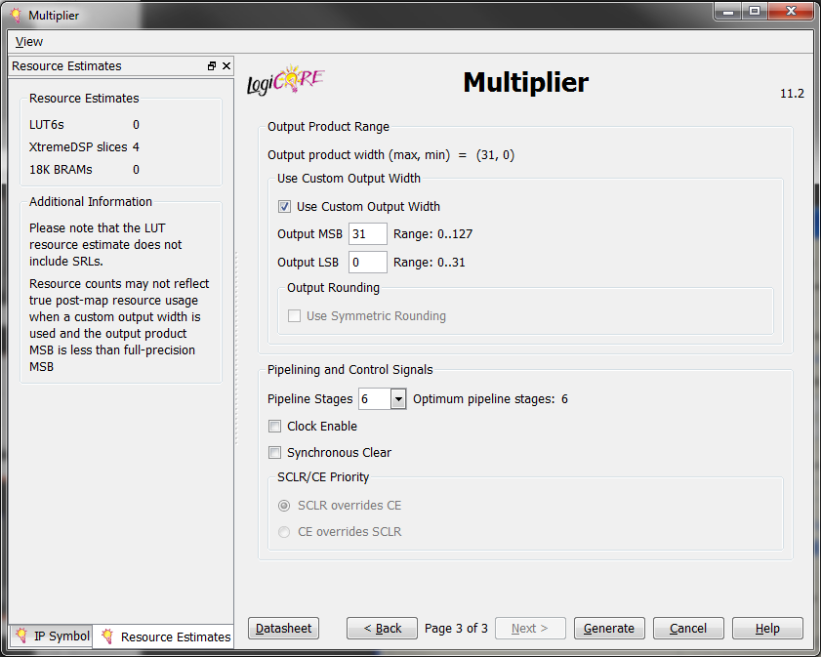
Multiplier

Slide 23
Up Counter
Although the up_counter module is present, it is currently lacking functionality.
Modify this file to implement a 20-bit up counter that is synchronously cleared to 0 when sclr is asserted and otherwise incremented every cycle (ignoring overflow).

Slide 24
Adding sources
In the Sources window, right click and select “Add Source”.
Choose “vgamult.ucf” from the “ece554” folder.
Copy the “numbers.mem” file from the “ece554” folder to the root directory of your project. (“I:\win\Desktop\LEDs\test123” in this example).
This memory file is used to initialize the simple_rom moudle in the project.

Slide 25
Synthesis and Programming
Now you should have a completed project that can be synthesized and programmed to the FPGA board.
Highlight the top level vgamult.v file in the sources window and select synthesize from the Process window
The operation should succeed with a few warnings.
Next Implement the design
This is composed of translating the high level structures into Xilinx board-level primitives and then selecting placement, given our selected FPGA board
Generate the programming file
Finally, select “Manage configuration project” from under the “Configure Target Device” listing in the Process window.

Slide 26
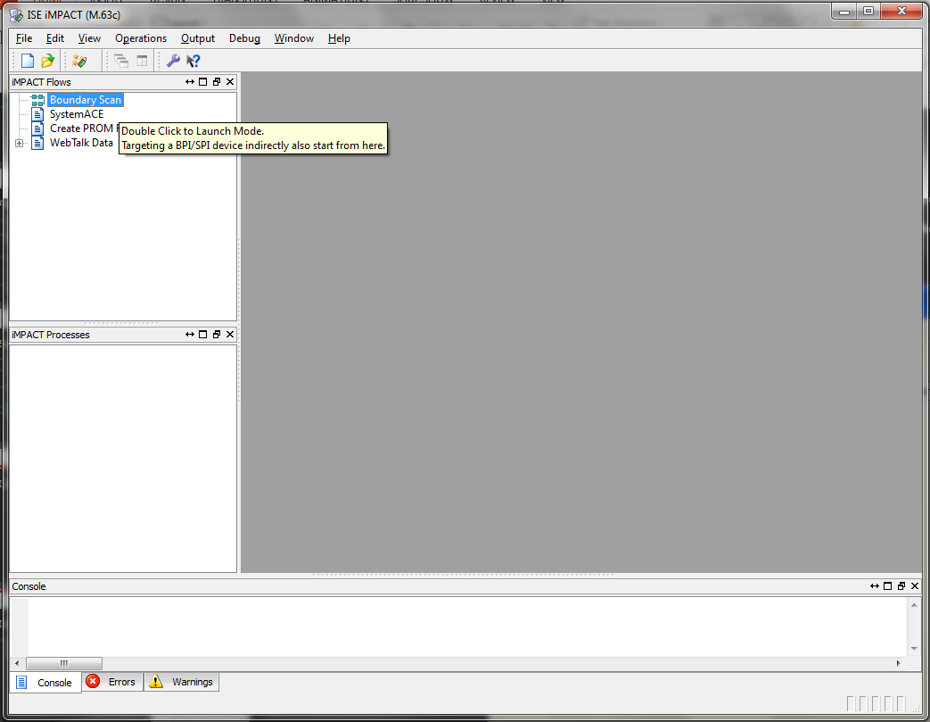
Configure Target Device
Double click on “Boundary scan”

Slide 27
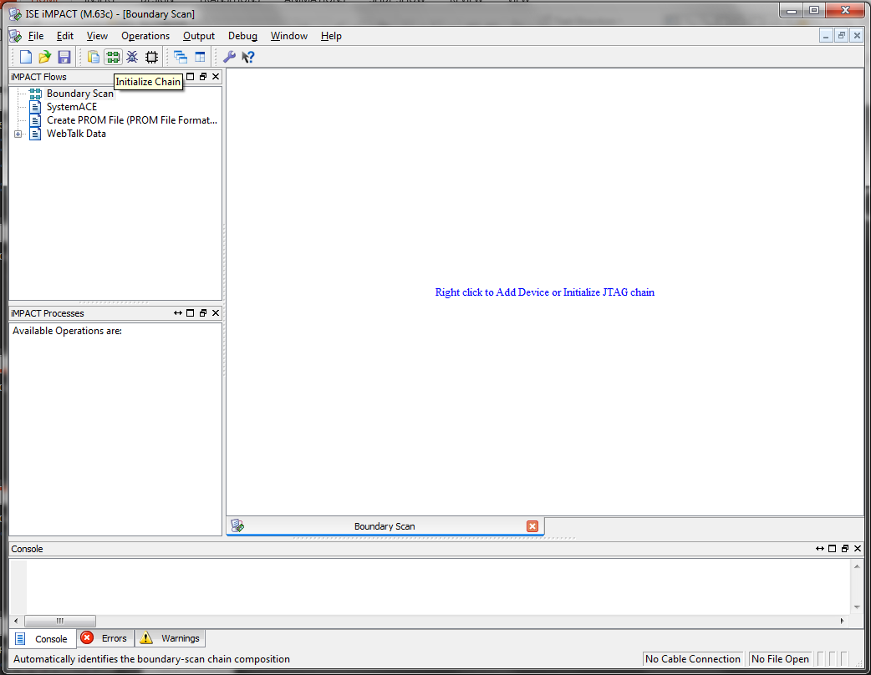
Configure Target Device
Initialize JTAG chain

Slide 28
Configure Target Device
The IMPACT program detects the chain of programmable devices present on our FPGA board. The 5th device is the actual XC5V-LX110T FPGA.
Bypass assigning configuration files for the first 4 devices
Assign new configuration file “vgamult.bit” to the FPGA. This is the bitfile necessary to program our final design.
After clicking through the other windows, right click on the 5th device and select Program.
Assuming the board programmed, you should be able to run the project now. The leftmost dip switch controls reset and the “arrow” push buttons increment/decrement the multiplicand and multiplier.

Slide 29
Pins UCF file
Earlier we somewhat ignored the Pins.ucf file, other than just adding it to the project.
Later you will have to modify UCF files in order to control pins on the board, so it is worthwhile now to inspect this file and see how it ties pins to the top level verilog module.
To add additional signals to this file, it is necessary to view the board documentation found at http://www.xilinx.com/univ/xupv5-lx110t.htm. The XUPV505-LX110T board is the same we use for this course.

Slide 30


